Slide 1

BACHLOR OF SCIENCE MATHEMATICS
Department of mathematics
Raja doraisingam govt arts & science college
Sivaganga-630553

Slide 2
Topic : Estimation of business expenses
TeamMates:
B . Sivadharshini : 0321121022
S . Yogeshwari : 0321121028
S . Packiya Mercy : 0321121014
M. Shalini : 0321121021
A . Shalini : 0321121020
Guided by :
K. Jeyapal

Slide 3
INTRODUCTION
Overview:
It provides an in-depth analysis of business expenses, highlighting their distribution and identifying the primary cost drivers within different businesses. Through the use of visual representations and interactive dashboards created using Tableau, the report aims to facilitate intuitive analysis for decision-makers, financial analysts, and stakeholders. Its primary goals are to uncover areas of potential optimization or concern, offer insights into the financial health of businesses, and enable informed decision-making to drive growth and resource optimization.
Purpose:
The purpose of the report and the visualization using Tableau is to provide a comprehensive understanding of the business's expenses, identify cost drivers, and highlight areas for potential optimization or concern. By presenting the data in an intuitive and visual manner, the report aims to empower decision-makers, financial analysts, and stakeholders to make informed decisions, optimize resources, and foster business growth

Slide 4
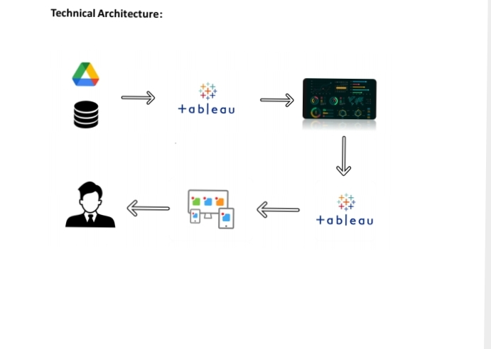
Estimation of Business Expenses
Problem Description:
This report delves into the fascinating realm of business expenses and provides
a visual exploration of the various expenditures incurred by different
businesses. It showcases the distribution of expenses, identifies key cost
drivers, and highlights areas of potential optimization or concern. The visual
representations allow for intuitive analysis, facilitating a deeper understanding
of expenditure patterns and their implications for business performance.
Decision-makers, financial analysts, and stakeholders can gain valuable insights
into the financial health of businesses, identify areas of inefficiency or
opportunity, and make informed decisions to optimize resources and drive
growth. To Extract the Insights from the data and put the data in the form of
visualizations, Dashboards and Story we employed Tableau tool.

Slide 5
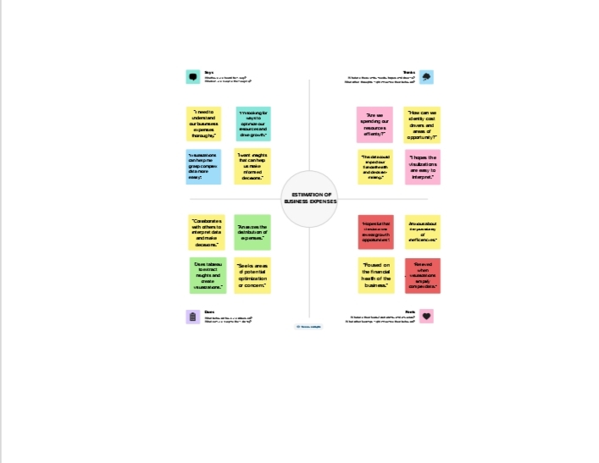
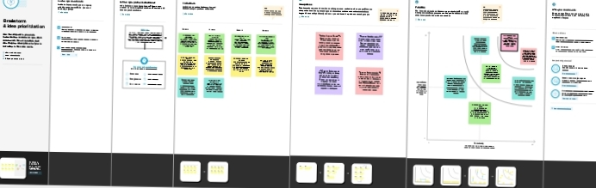
Empathy Map & Brain stroming Map:

Slide 6
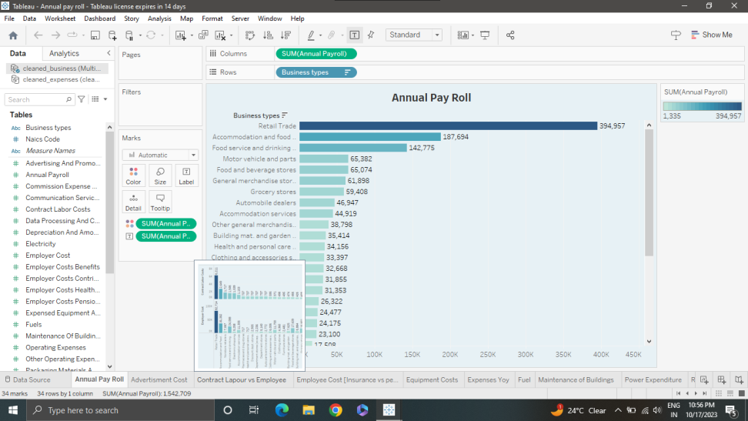
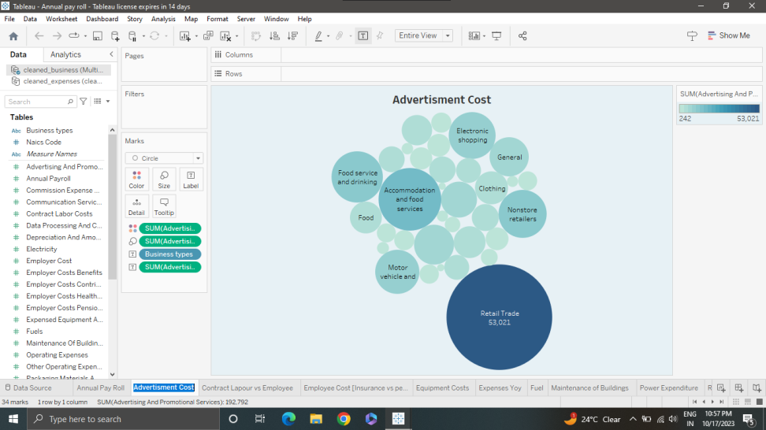
Data visualizations :
Annual pay roll:
Advertisement cost:

Slide 7
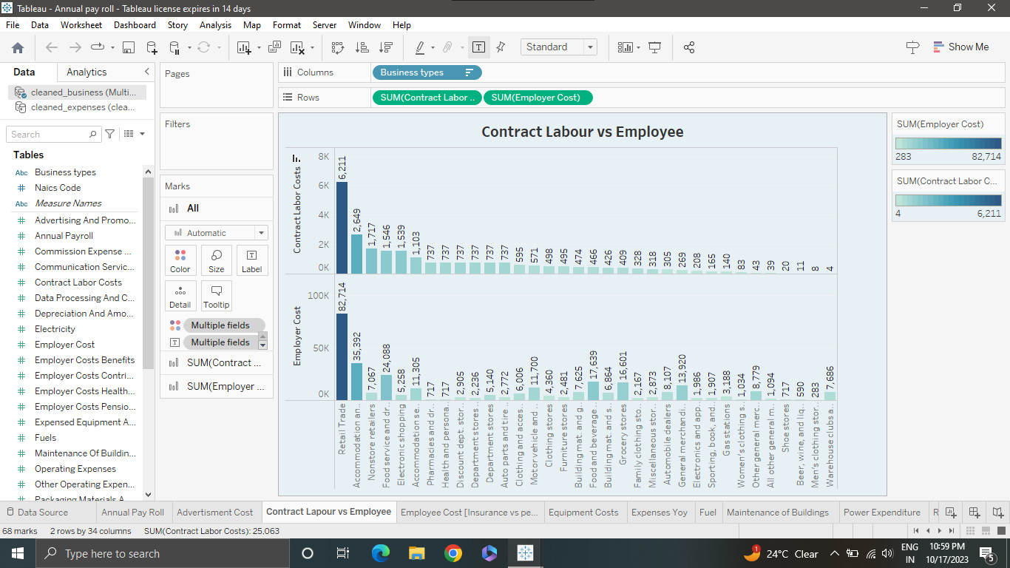
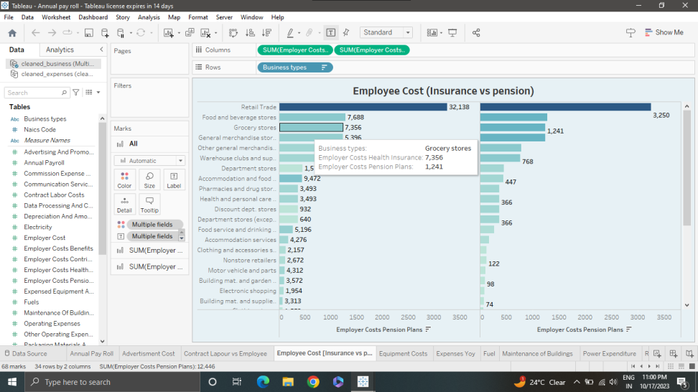
Data Visualization
Contract Labour vs Employee :
Employee (Insurance vs Pension):

Slide 8
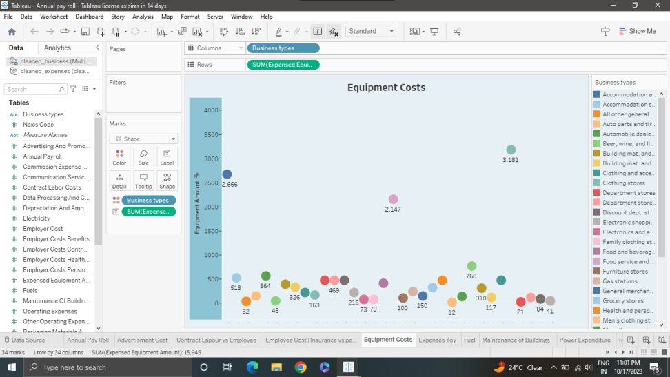
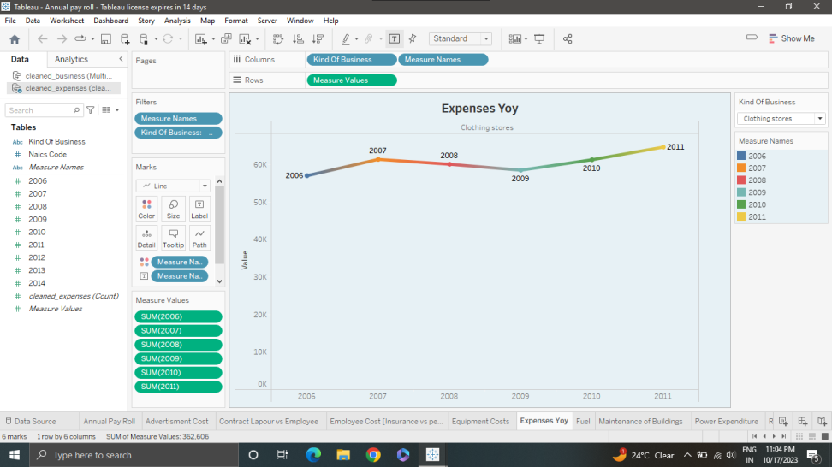
Data Visualization
Equipment Costs :
Expenses YoY :

Slide 9
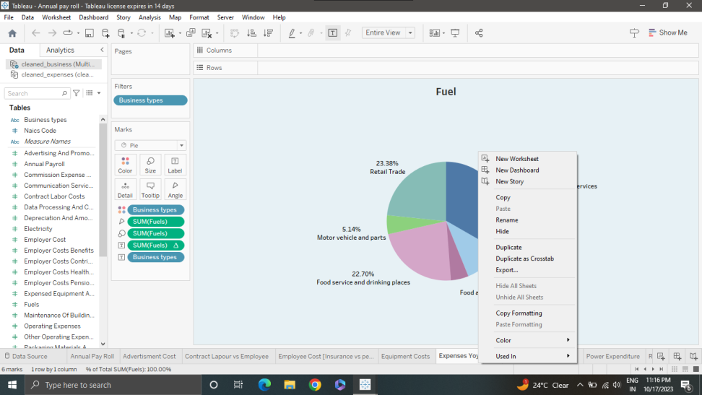
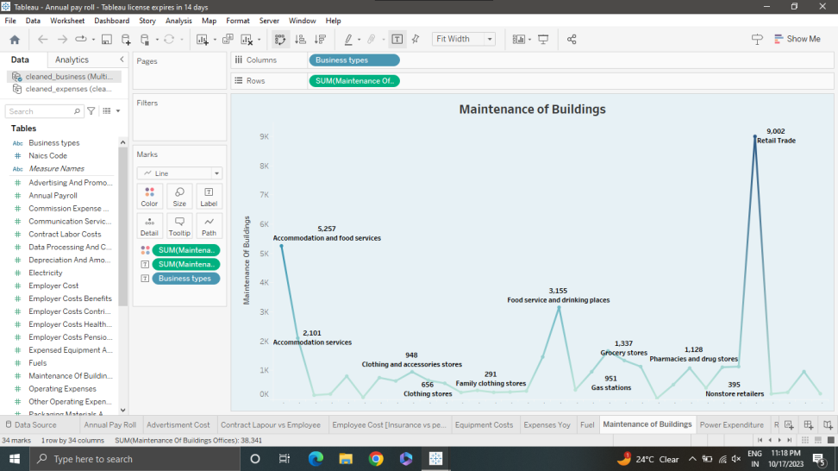
Data Visualization
Fuel :
Maintenance of Bulidings:

Slide 10
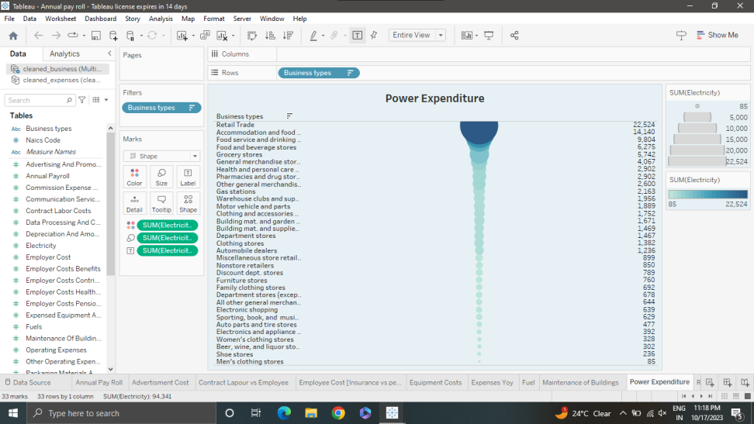
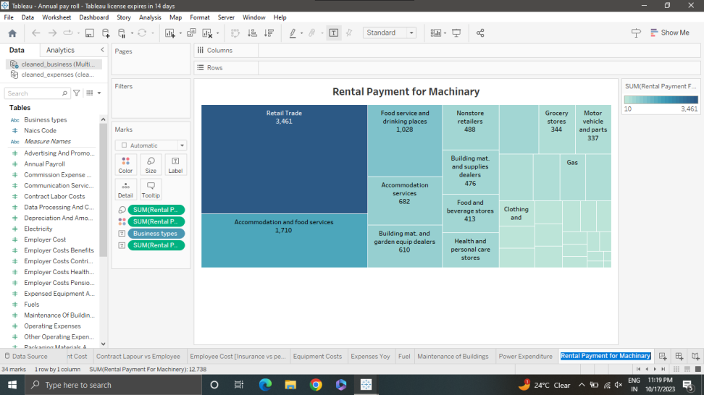
Data Visualization
Power Expenditure :
Rental Payment Machinery :

Slide 11
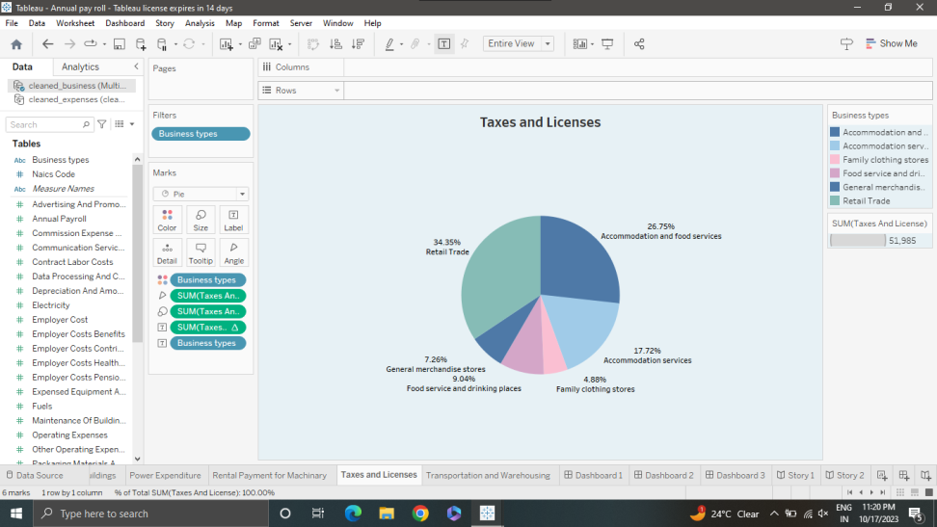
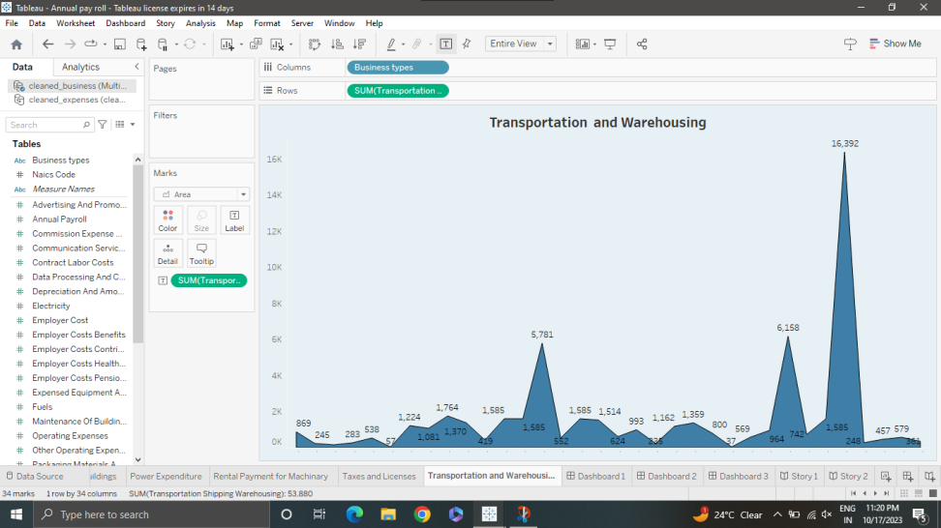
Data Visualization
Taxes & Licenses :
Transportation :

Slide 12
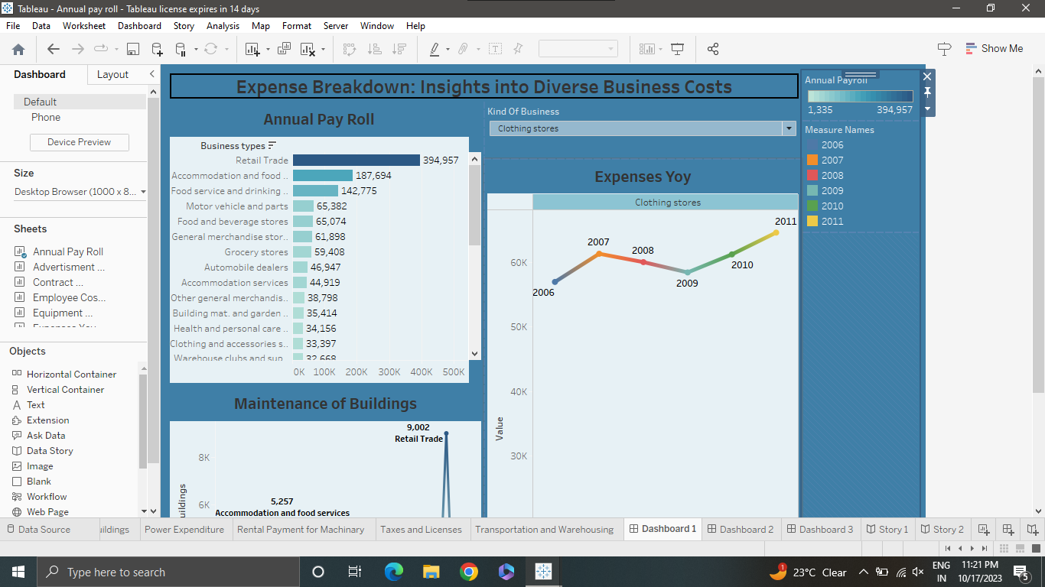
Dashboard 1 :

Slide 13
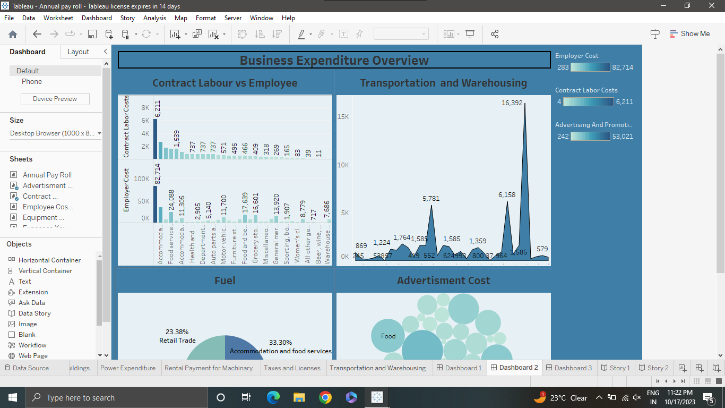
Dashboard 2 :

Slide 14
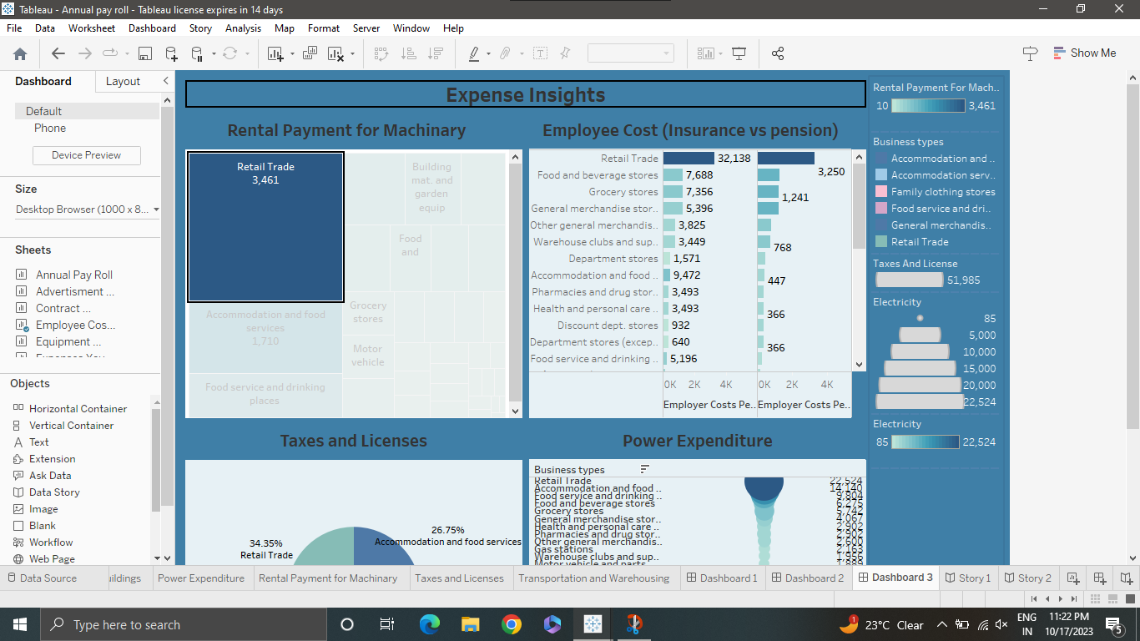
Dashboard 3 :

Slide 15
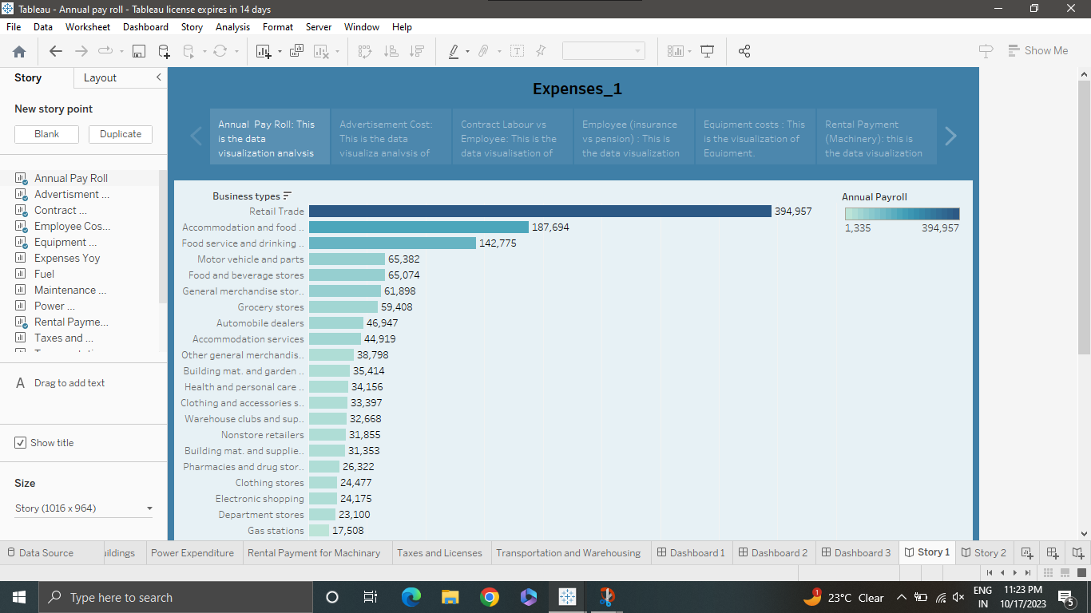
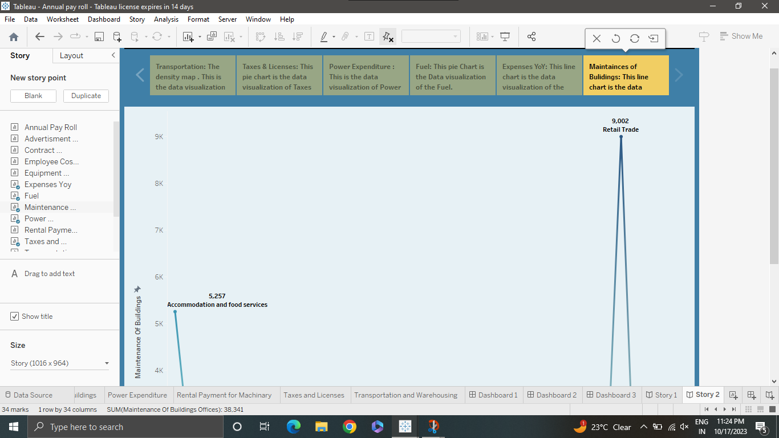
Story
story 1 :
Story 2 :

Slide 16
Conclusion
Based on the utilization of Tableau for data analysis, the report can conclude that the visual representations and dashboards created provide a comprehensive understanding of business expenses and their implications. By highlighting key cost drivers and areas of potential optimization or concern, stakeholders can make informed decisions to improve financial health and drive growth.
Furthermore, the visualizations generated through Tableau offer an intuitive way to identify areas of inefficiency or opportunity, enabling decision-makers and financial analysts to optimize resources effectively. Overall, the utilization of Tableau has enhanced the ability to extract meaningful insights from the data, empowering businesses to make data-driven decisions and achieve better financial performance.

Slide 17
Thank you !

